Slide 1
2020
Point In Time Homeless
Count
FAYETTEVILLE/CUMBERLAND COUNTY

Slide 2
On the night during the last week of January 29, 2020
297
Total people experienced homelessness in
Fayetteville/Cumberland County North Carolina.

Slide 3
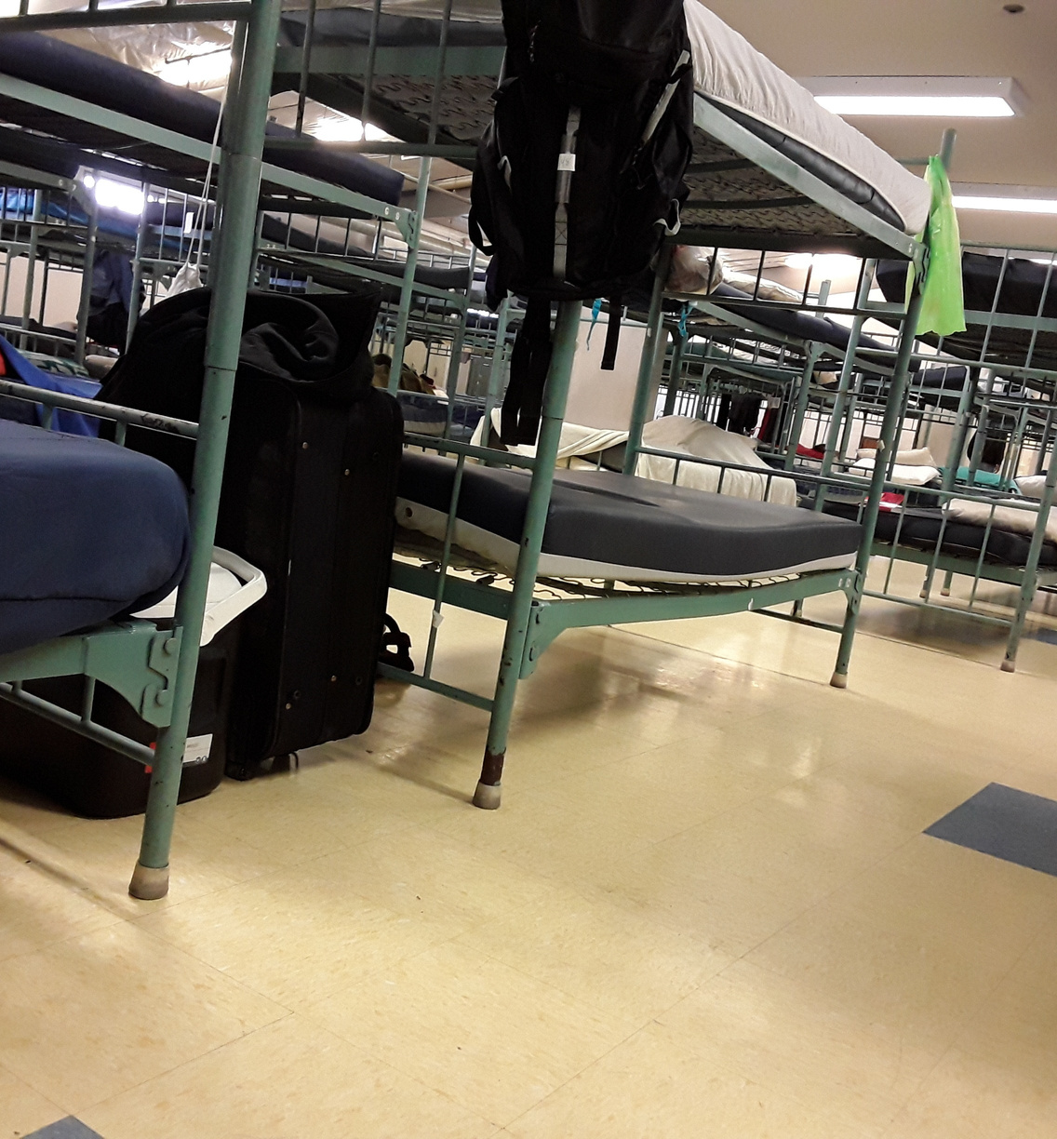
38
38 HOUSEHOLDS RESIDED IN EMERGENCY SHELTERS
Emergency Shelter (ES)
Any facility that the primary purpose of which is to provide temporary or transitional shelter for the homeless in general or for a specific subpopulation of the homeless.

Slide 4
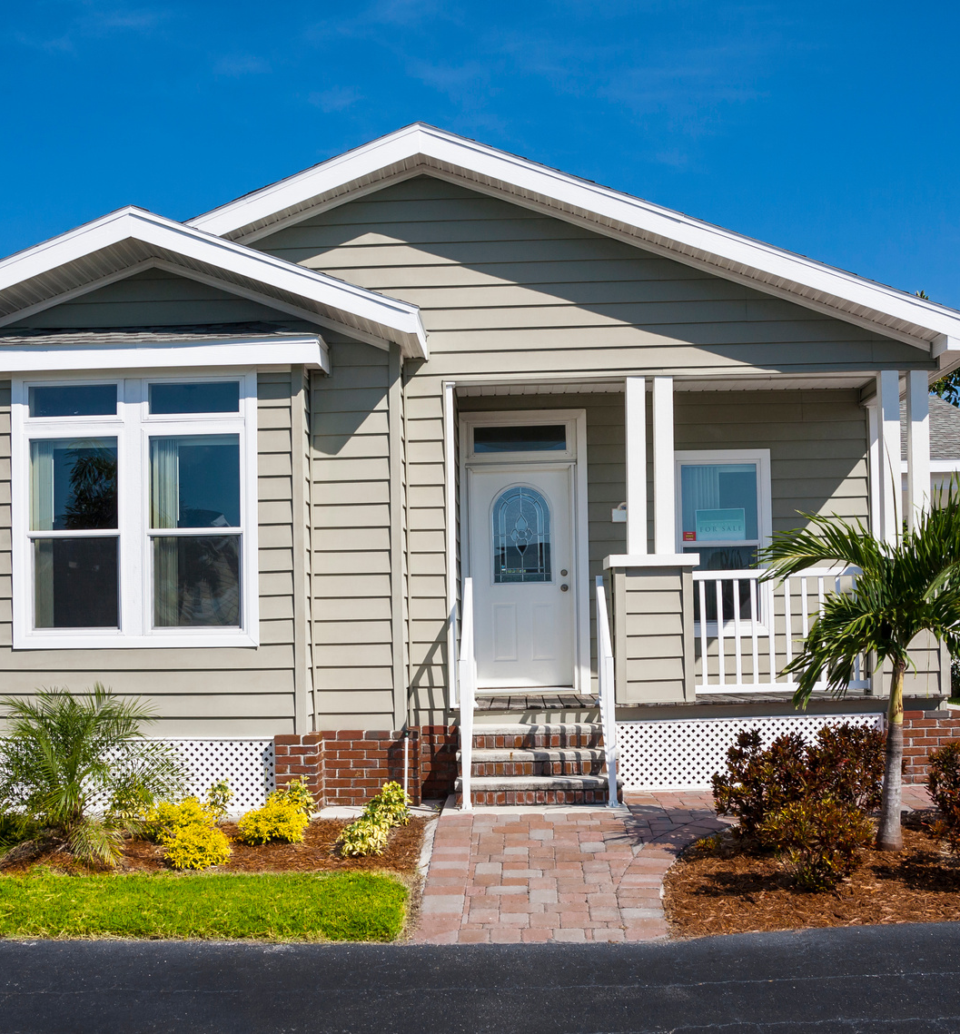
94
94 HOUSEHOLDS RESIDED IN TRANSITIONAL HOUSING
Transitional Housing (TH)
Supportive housing used to facilitate the movement of homeless individuals and families to permanent housing. It is housing in which homeless persons may live up to 24 months and receive supportive services then enable them to live more independently.

Slide 5
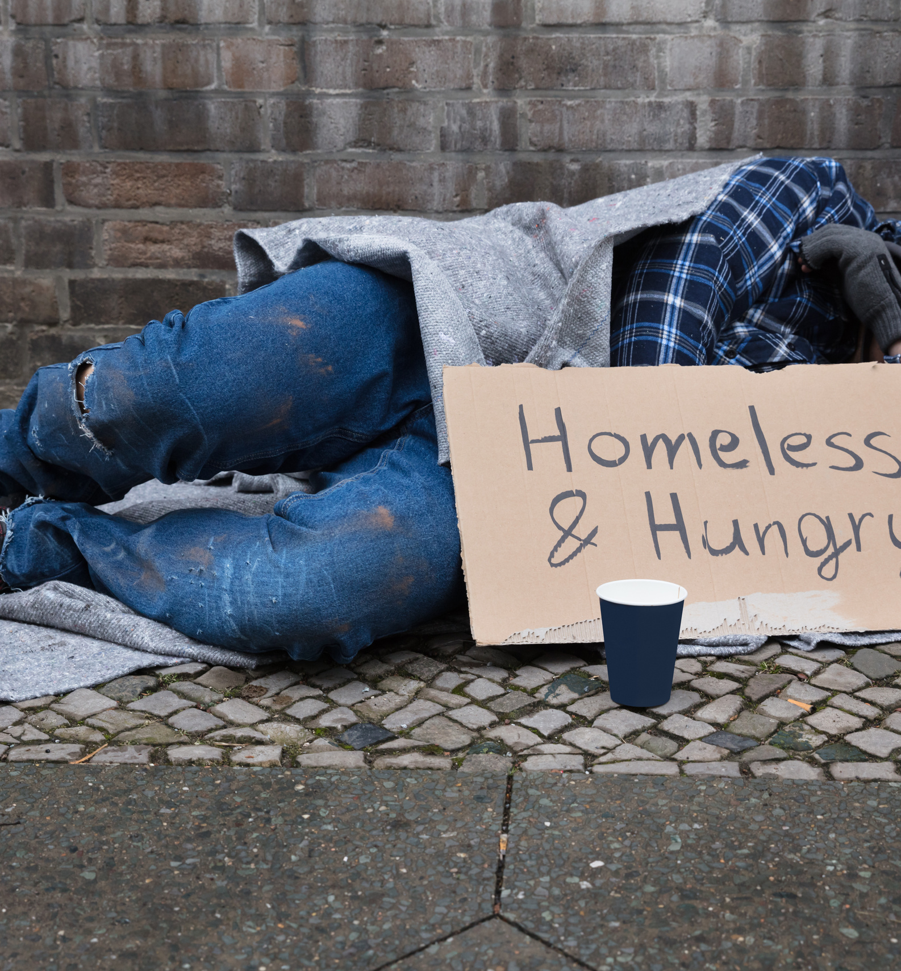
165
165 PEOPLE LIVED IN UNSHELTERED CONDITIONS
Unsheltered Homeless Persons
An individual or family with a primary nighttime residence that is a public or private place not designed for or ordinarily used as a regular sleeping accommodations for human beings, including a car, park, abandoned building, bus or train station, airport or campground.

Slide 6
TOTAL VETERAN COUNT
EMERGENCY SHELTERS
SHELTERED HOUSING
UNSHELTERED
Total Number of Households: 0
Total Number of Persons: 0
Total Number of Veterans: 0
Total Number of Households: 0
Total Number of Persons: 0
Total Number of Veterans: 0
Total Number of Households: 27
Total Number of Persons: 44
Total Number of Veterans: 28

Slide 7
34
Homeless Adults admitted to having a serious Mental Illness

Slide 8
15
Homeless Adults admitted to having a Substance Disorder

Slide 9
2
Homeless Adults with HIV/Aids

Slide 10
23
Homeless
Adult Survivors
of
Domestic Violence

Slide 11
Behavioral Health System/Mental Health Substance Abuse
Criminal Justice System
Healthcare System
HOMELESS DISCHARGED FROM FACILITIES
14
7
14

Slide 12
HOMELESS
Homeless: An individual who lacks a fixed, regular, and adequate nighttime residence: as well an individual who has a primary nighttime residence that is a supervised publicly or a privately operated shelter designed to provide temporary living accommodations, an institution that provides a temporary residence for individuals intended to be institutionalized; or a public or private place not designed for, or ordinarily used as a regular sleeping accommodation for human beings.
Changes in the HUD Definition of "Homelessness" . Retrieved from https://endhomelessness.org/resource/changes-in-the-hud-definition-of-homeless/

Slide 13
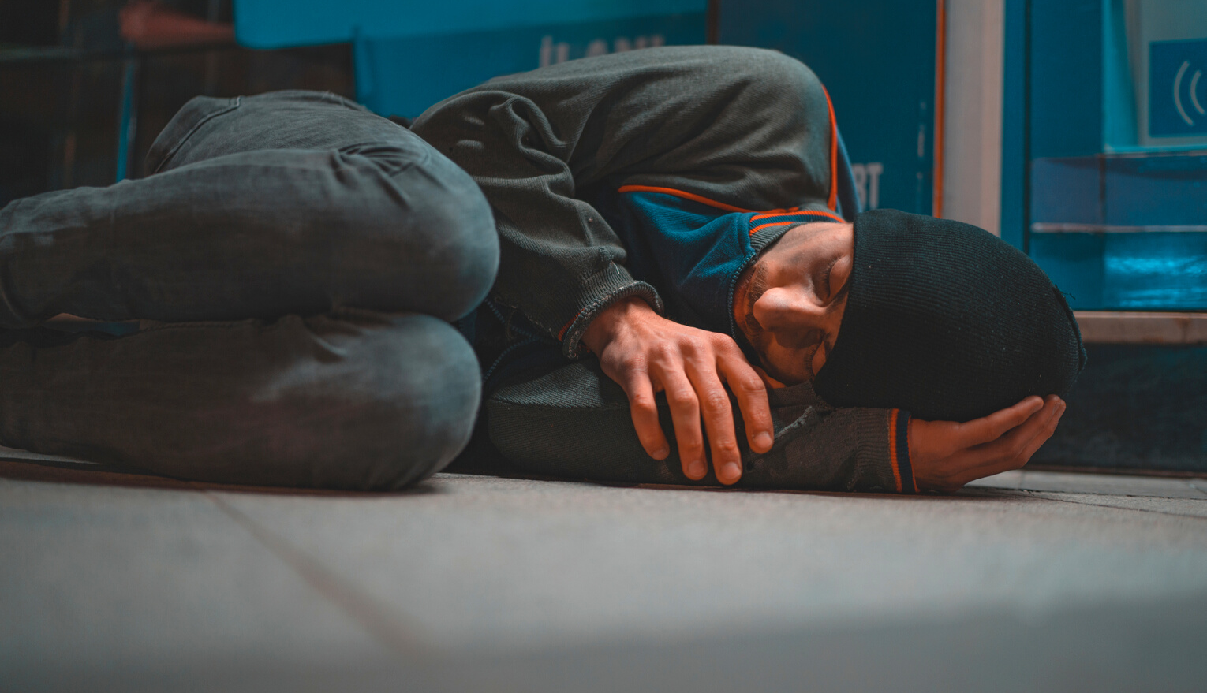
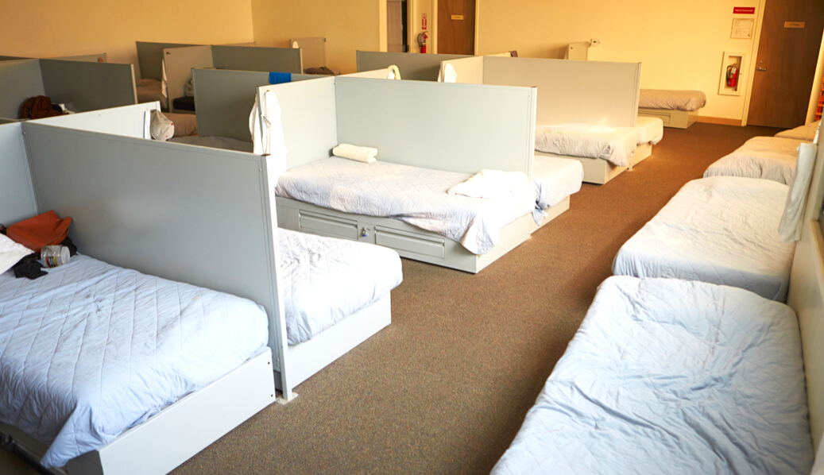
Three (3) Different Types of Homelessness
Sheltered Homelessness
Imminent Risk of Homelessness
Unsheltered Homeless
Those who are living in uninhabitable places for people to normally dwell such as: living on the street, in cars, abandoned houses, public benches, parks, doorways to businesses and other places that can be found for shelter.
Individuals who are not living on the street but are not living on their own either. Those living in transitional housing (temporary housing) such as domestic violence shelters, emergency shelters, hotel, motels and safe havens.
Those who will lose their primary residence within 14 days and they have no other housing and lack the resources to obtain housing. Those living on the couches of another persons' home and depending on the kindness of others.
I
Glossary of HUD Terms, HUD.Gov, Retrieved June 5, 2019 from https://archives,huduser.gov/portal/glossary/glossary_s.html

Slide 14
All homeless people are lazy and don't want to work
Homeless persons choose to be homeless.
All homeless persons abuse alcohol and drugs.
Helping homeless persons only enables them
MISCONCEPTIONS
HOMELESSNESS
IT'S MORE THAN YOU KNOW!
Those misconceptions are not true, homelessness is closer to one's door than you know.
SERIOUS TRUTH
Many may not realize it, but any individual or family can possibly experience homelessness by the loss of as little as two monthly paychecks due to an unforeseen event that could arise.
IT COULD HAPPEN TO YOU
Myths about Homelessness. Frontsteps.org. Retrieved from https://frontsteps.org/homeless-myths/

Slide 15
Common Myths About Homelessness
There are many negative stereo types and personal misperceptions that lead to myths about homelessness
All homeless people are bums.
All homeless people are service resistant.
All homeless people are lazy.
All homeless people are thieves.
Homelessness will never end.
They are dangerous and violent
They are criminals
Most are mentally ill.
The homeless are not a part of "our community".
All homeless people choose to be homeless.
All homeless people flow to our city for services.
Helping homeless people only enables them.
All homeless people sleep all the time.
All homeless people abuse drugs and alcohol.
They just need to get a job.
They live in unsatisfactory conditions because they don't care.
MYTHS AND MISPERCEPTIONS
The 12 Biggest Myths about Homelessness in America, 2019. https://www.nyu.edu/about/news-publications/news/2019/september/HomelessQandA.html

Slide 16
Most Common Causes of Homelessness
Loss of Employment.
Family Crisis: Divorce, loss of loved one,
Medical crisis.
Lack of affordable housing, eviction
Mental and or Physical Disability
Drugs/Alcohol
Domestic Violence
Incarceration
Poverty
COVID
7 Major Causes of Homelessness. Retrieved from heeps://atlantamission.org/7-major-causes-homelessness/

Slide 17
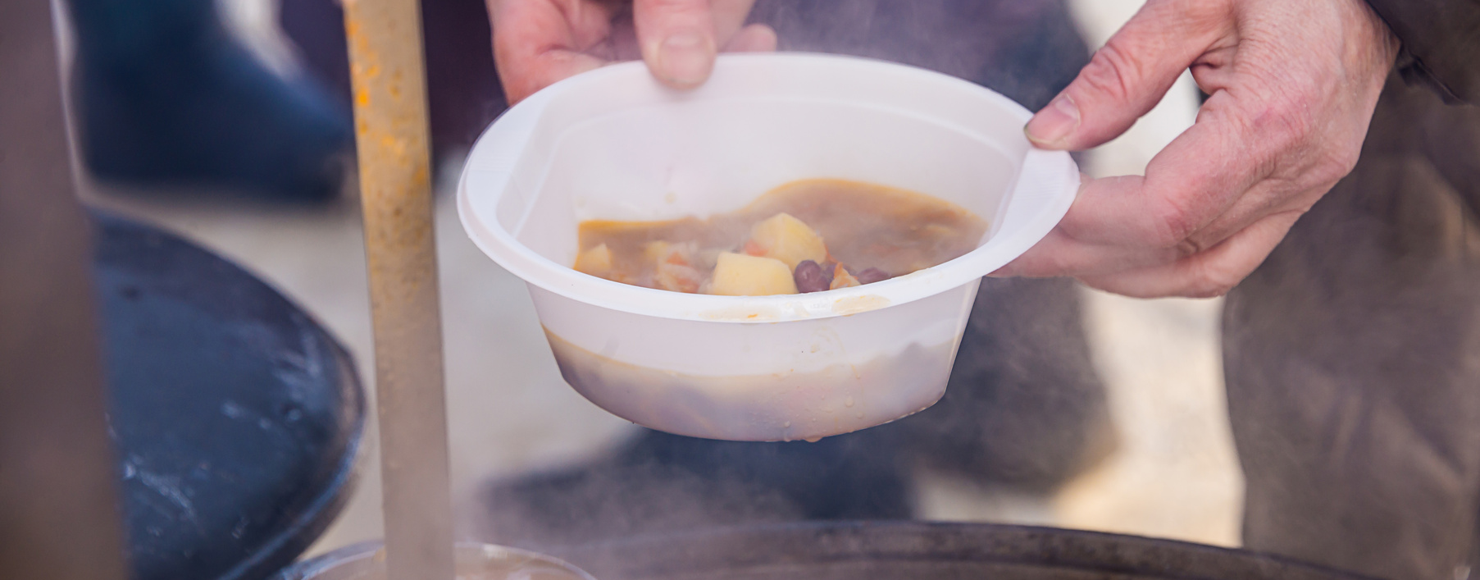
Understanding the Point in Time Count (PIT)
This report is intended to provide the community with vital information regarding the many different characteristics of our homeless community. The collection of surveys is one way we use to count our homeless community. Although the surveys are thorough, they do come with limitations. The task of counting those who are experiencing homelessness is not an easy task to complete in only one night.

Slide 18
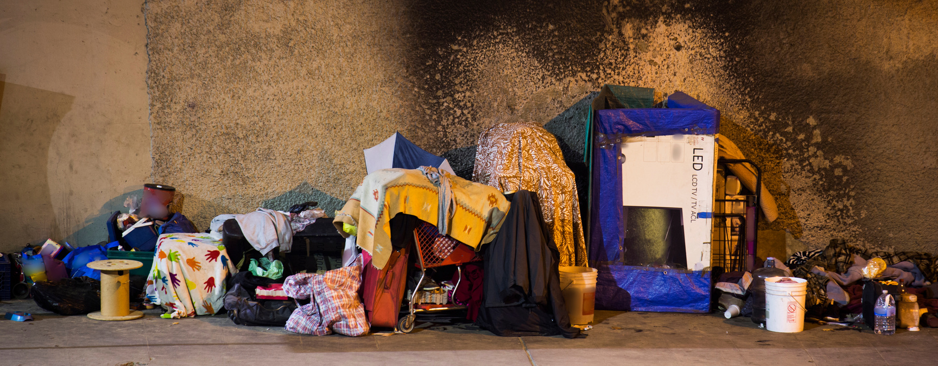
Understanding the Point in Time Count (PIT)
Although it is our goal to reach every homeless person in our community, it is almost nearly impossible to locate everyone. This count is only as accurate as the number of individuals that are located. The Point in Time Count is a snapshot of our community. These snapshots are taken each year in the hope that over a course of time we are able to observe changes and evaluate our progress in our goal to end homelessness and create an environment where everyone can live in
a safe and comfortable dwelling.

