Slide 1
2021
Point In Time
Sheltered Count
Fayetteville/Cumberland County
Dedicated to making homelessness: Rare, Brief and Non-Recurring

Slide 2
Words from the NC-511 Continuum of Care
In an effort to ensure the safety of both our Point in Time volunteer census takers and our homeless community, it was decided that only a Sheltered Count would be conducted this year due to Covid-19 guidelines
NC-511 Cumberland County Fayetteville

Slide 3
2021
Point In Time
Sheltered Count
Fayetteville/Cumberland County
Dedicated to making homelessness: Rare, Brief and Non-Recurring

Slide 4
54
Sheltered Homeless Individuals and Families
On the night of January 27, 2021 there was a total of 54 sheltered homeless individuals and families. This is a decreased believed to be impacted by Covid 19.

Slide 5
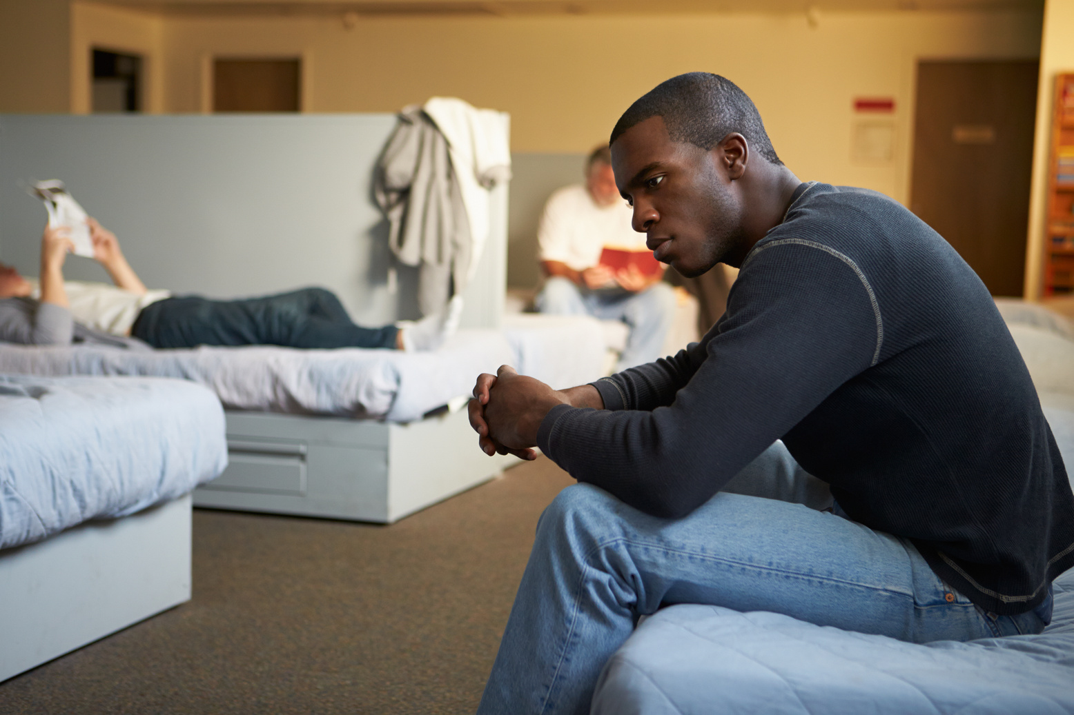
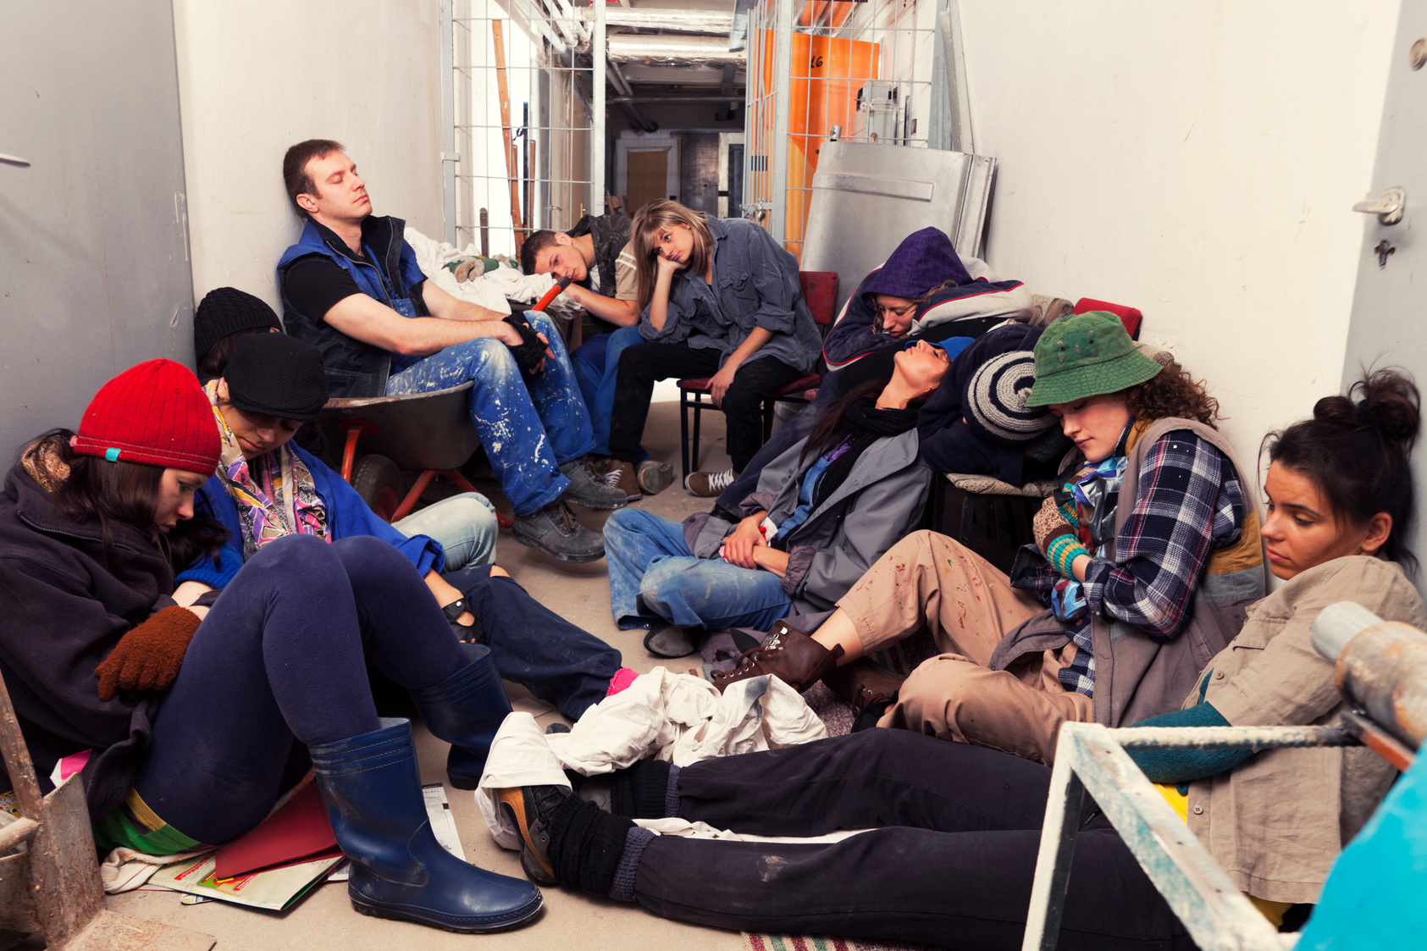
Total Veteran Count
Emergency Shelter
Safe Haven
Transitional Housing
Total
Total Number of Households 1
Total Number of Persons 2
Total Number of Veterans 1
Total Number of Households 2
Total Number of Persons 3
Total Number of Veterans 2
Total Number of Households 1
Total Number of Persons 1
Total Number of Veterans 1
Images, 2021. Canva Images. Retrieved March 29, 2021 from https://www.Canva.com

Slide 6
2
Sheltered Homeless Individuals and Families
Homeless Adults admitted to having a Serious Mental Illness

Slide 7
1
Sheltered Homeless Individuals and Families
Homeless Adults admitted to having a Substance Use Disorder

Slide 8
0
Sheltered Homeless Individuals and Families
Adults with HIV/AIDS

Slide 9
12
Sheltered Homeless Individuals and Families
Adult Survivors of Domestic Violence

Slide 10
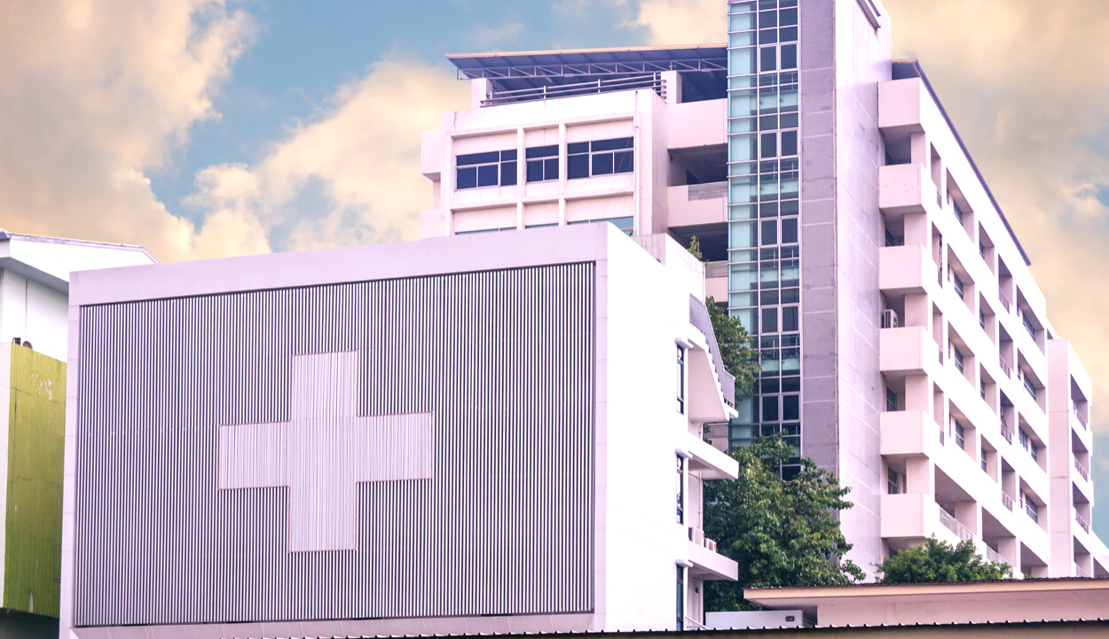
Criminal Justice System
Behavioral Health
Substance Abuse
Healthcare System
Homeless Discharged from Facilities
Emergency Shelter: 0
Transitional House: 0
Total: 0
Emergency Shelter: 0
Transitional House: 0
Total: 0
Emergency Shelter: 0
Transitional House: 0
Total: 0

Slide 11
HOMELESS
Homeless: An individual who lacks a fixed, regular, and adequate night time residence: as well an individual who has a primary nighttime residence that is a supervised publicly or privately operated shelter designed to provide temporary living accommodations, an institution that provides a temporary residence for individuals intended to be institutionalized; or a public or private place not designed for, or ordinarily used as, a regular sleeping accommodation for human beings.
Changes in the HUD Definition of "Homelessness" . Retrieved from https://endhomelessness.org/resource/changes-in-th-hud-definition-of-homeless/

Slide 12
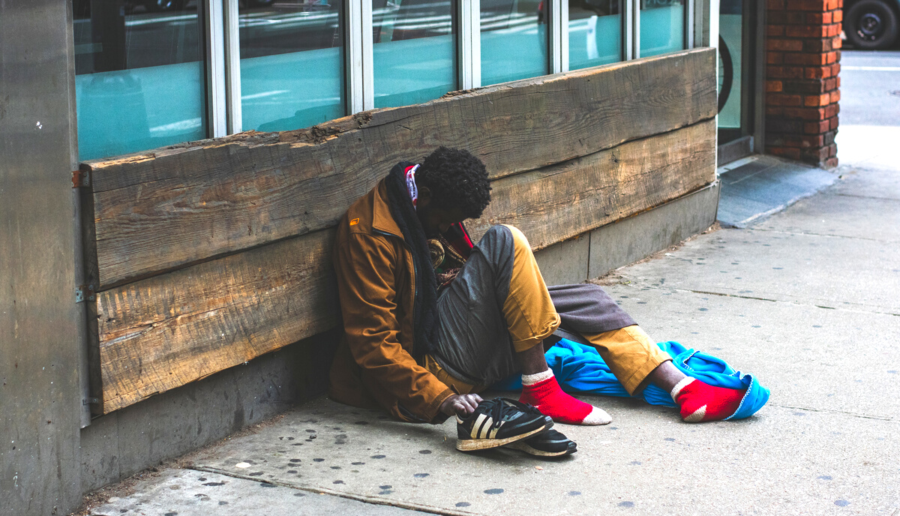
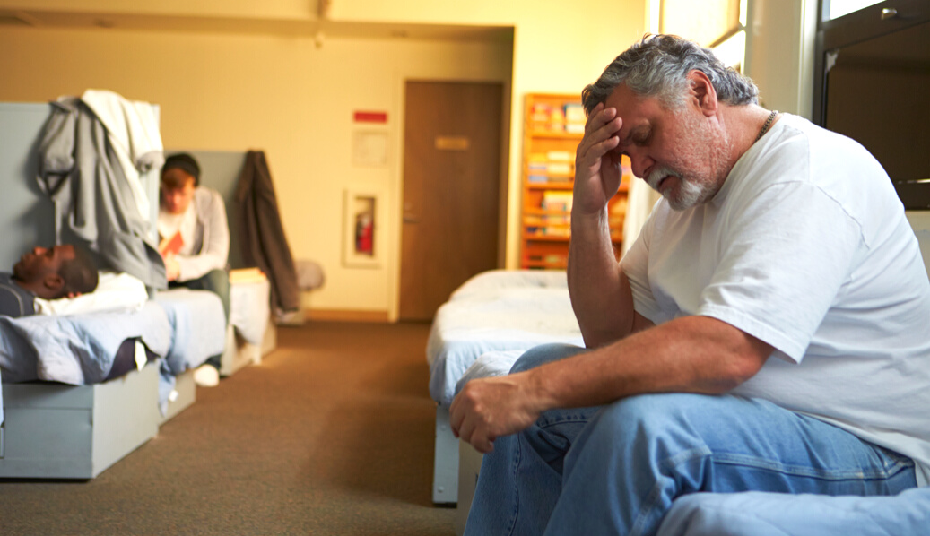
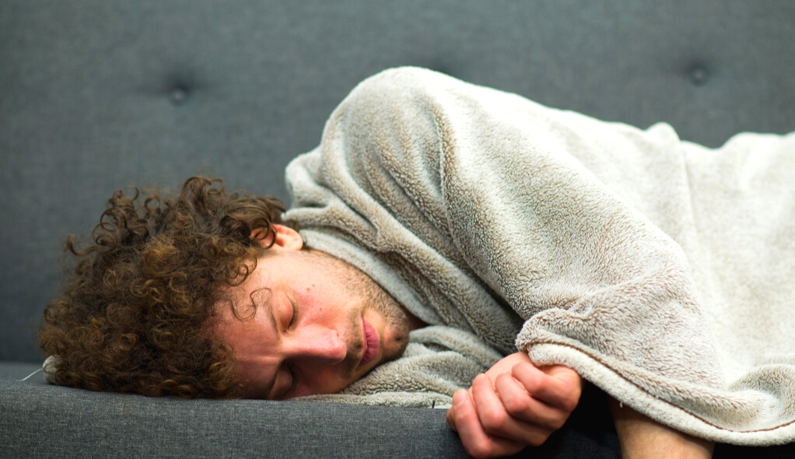
Three (3) Different Types of Homelessness
Unsheltered Homeless
Sheltered Homelessness
Imminent Risk of Homelessness
Those who are living in uninhabitable places for people to normally dwell such as: living on the street, in cars, abandoned houses, public benches, parks, doorways to businesses and other places that can be found for shelter.
Individuals who are not living on the street but are not livingon their own either. Those living in transitional housing (temporary housing) such as domestic violence shelters, emergency shelters, hotel, motels and safe havens.
Those who will lose their primary residence within 14 days and they have no other housing and lack the resources to obtain housing. Those living on the couches of another persons' home and depending on the kindness of others.
Glossary of HUD Terms, HUD.Gov, Retrieved June 5, 2019 from https://archives,huduser.gov/portal/glossary/glossary_s.html

Slide 13
All homeless people are lazy and don't want to work
Homeless persons choose to be homeless.
All homeless persons abuse alcohol and drugs.
Helping homeless persons only enables them
MISCONCEPTIONS
HOMELESSNESS
IT'S MORE THAN YOU KNOW!
Those misconceptions are not true, homelessness is closer to one's door than you know.
SERIOUS TRUTH
Many may not realize it, but any individual or family can possibly experience homelessness by the loss of as little as two monthly paychecks due to an unforeseen event that could arise.
IT COULD HAPPEN TO YOU

Slide 14
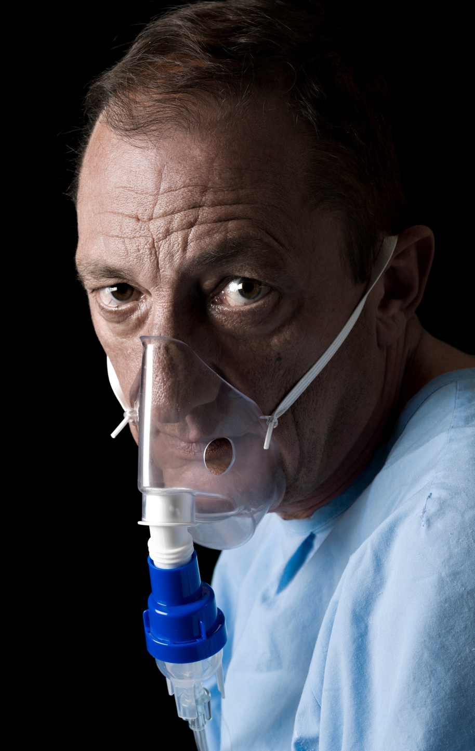
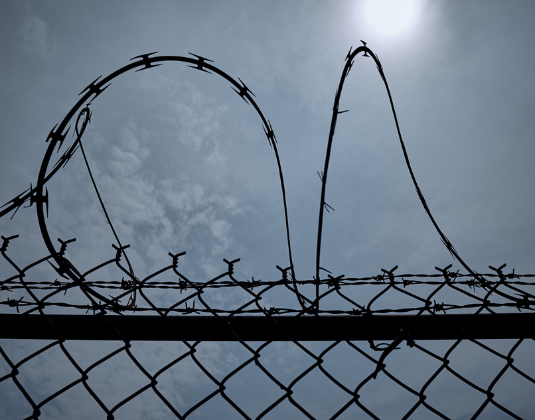
Most Common Causes of Homelessness
Loss of Employment.
Family Crisis: Divorce, loss of loved one, medical crisis.
Lack of affordable housing, eviction
Mental and or Physical Disability
Drugs/Alcohol
Domestic Violence
Incarceration
Poverty
7 Major Causes of Homelessness. Retrieved from heeps://atlantamission.org/7-major-causes-homelessness/

Slide 15
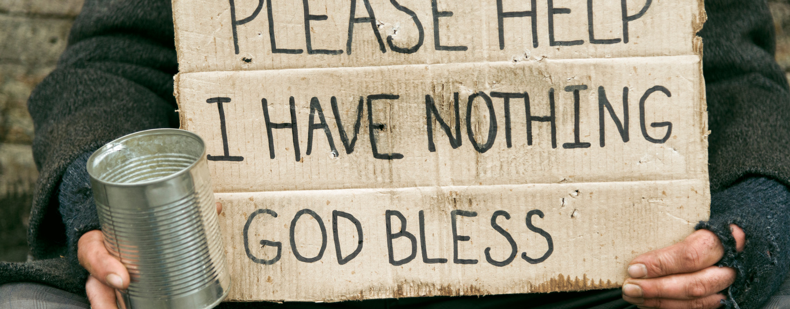
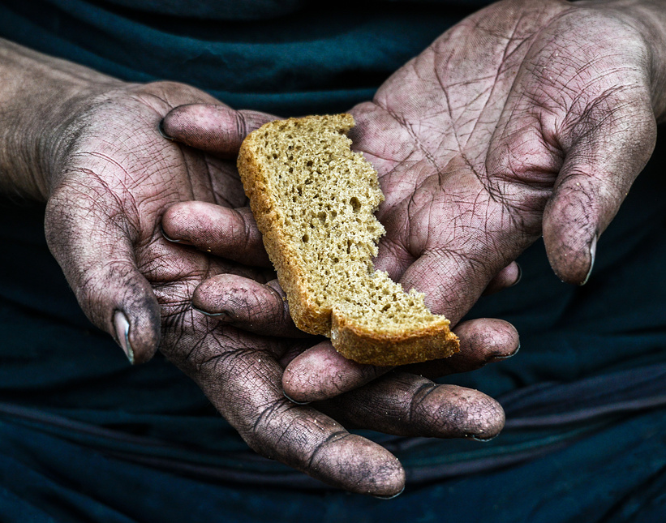
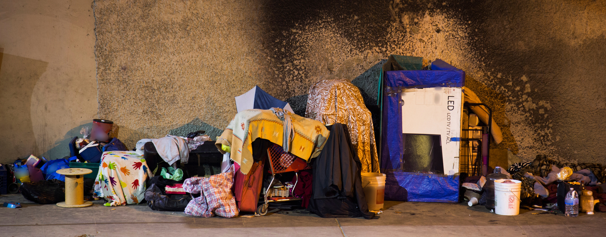
Understanding the Point in Time Count (PIT)
This report is intended to provide the community with vital information regarding the many different characteristics of our homeless community. The collection of surveys is one way we use to count our homeless community. Although the surveys are thorough, they do come with limitations. The task of counting those who are experiencing homelessness is not an easy task to complete in only one night.

Slide 16
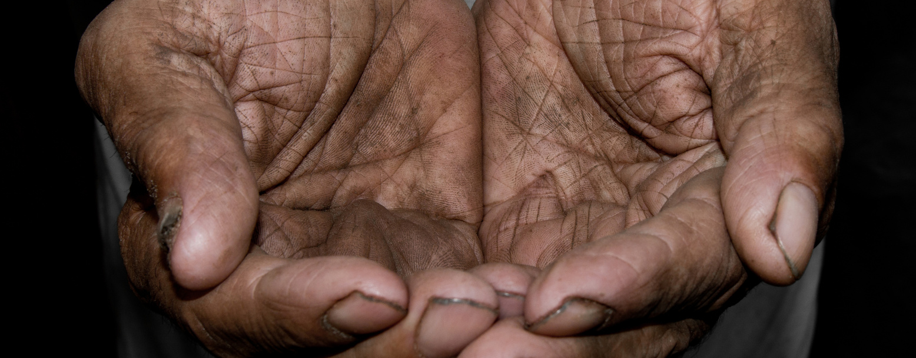
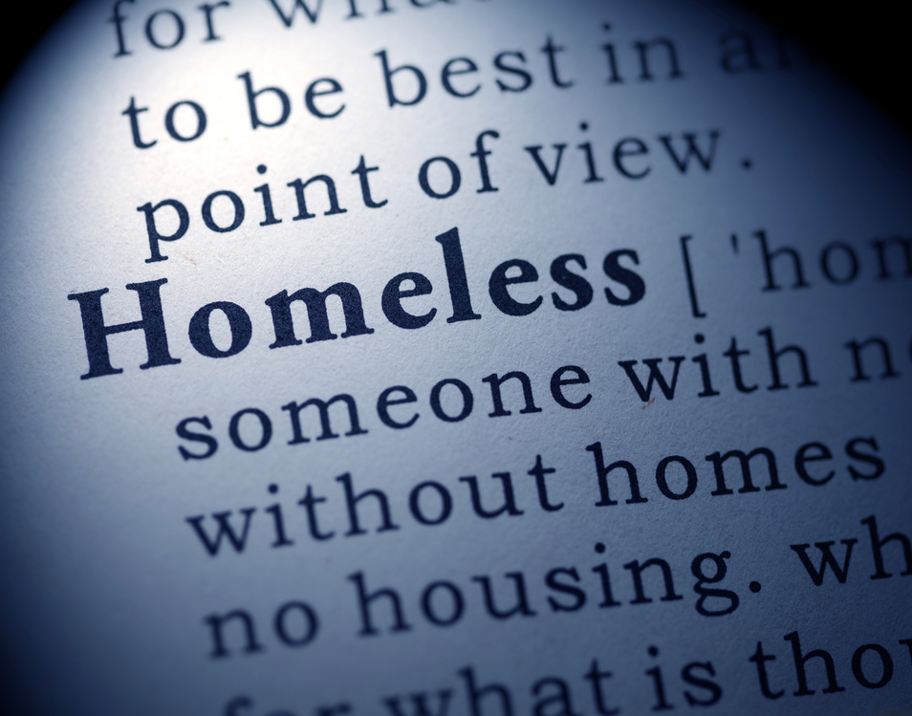
Understanding the Point in Time Count (PIT)
Although it is our goal to reach every homeless person in our community, it is almost nearly impossible to locate everyone. This count is only as accurate as the number of individuals that are located. The Point in Time Count is a snapshot of our community. These snapshots are taken each year in the hope that over the course of time, we are able to observe changes and evaluate our progress in our goal to end homelessness and create an environment where everyone can live in
a safe and comfortable dwelling.

Slide 17
TO OUR VOLUNTEERS
We would like to extend a special thank you to all the volunteers who gave of their time, talent, and resources to assist us during the Point-in-Time Count.
Words could never express our gratitude and appreciation.
We could not have done it without you.
This report was funded by Cumberland County Community Development, in direct partnership with the City of Fayetteville Economic and Community Development.
Prepared by Tawana Dawkins for the NC-511 Fayetteville/Cumberland County Continuum of Care.
Point of Contact: Delores Taylor, Director
Cumberland County Community Development.

