Slide 1
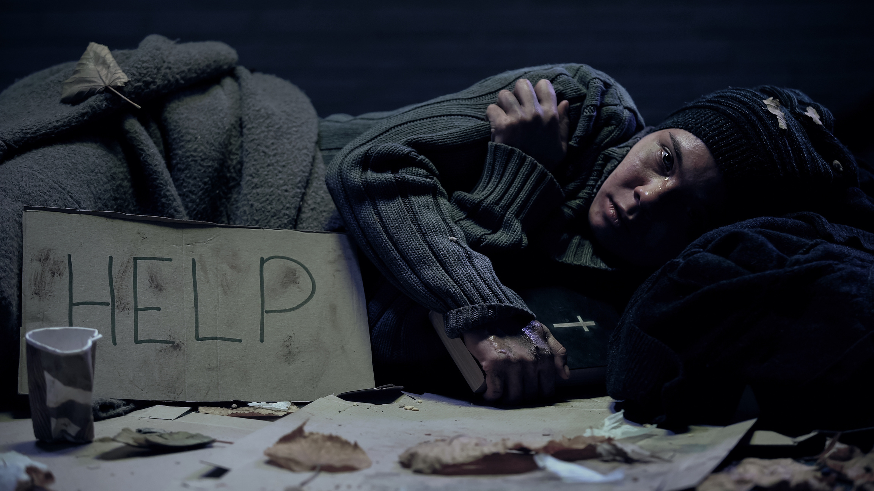
Fayetteville/Cumberland County
2023 Point In Time Count
Cumberland County Community Development

Slide 2
474
Sheltered and Unsheltered Homeless Individuals and Families
On the night of February 3, 2023, there was a total of 474 sheltered and unsheltered homeless individuals and families.

Slide 3
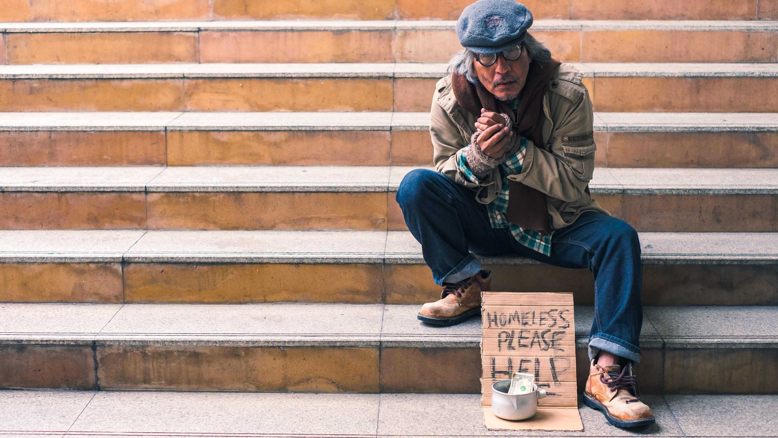
388
Unsheltered Homeless Individuals and Families
From the time period of:
February 2, 2023 - February 3, 2023
(388 Unsheltered)
people were experiencing homelessness
Unsheltered Count

Slide 4
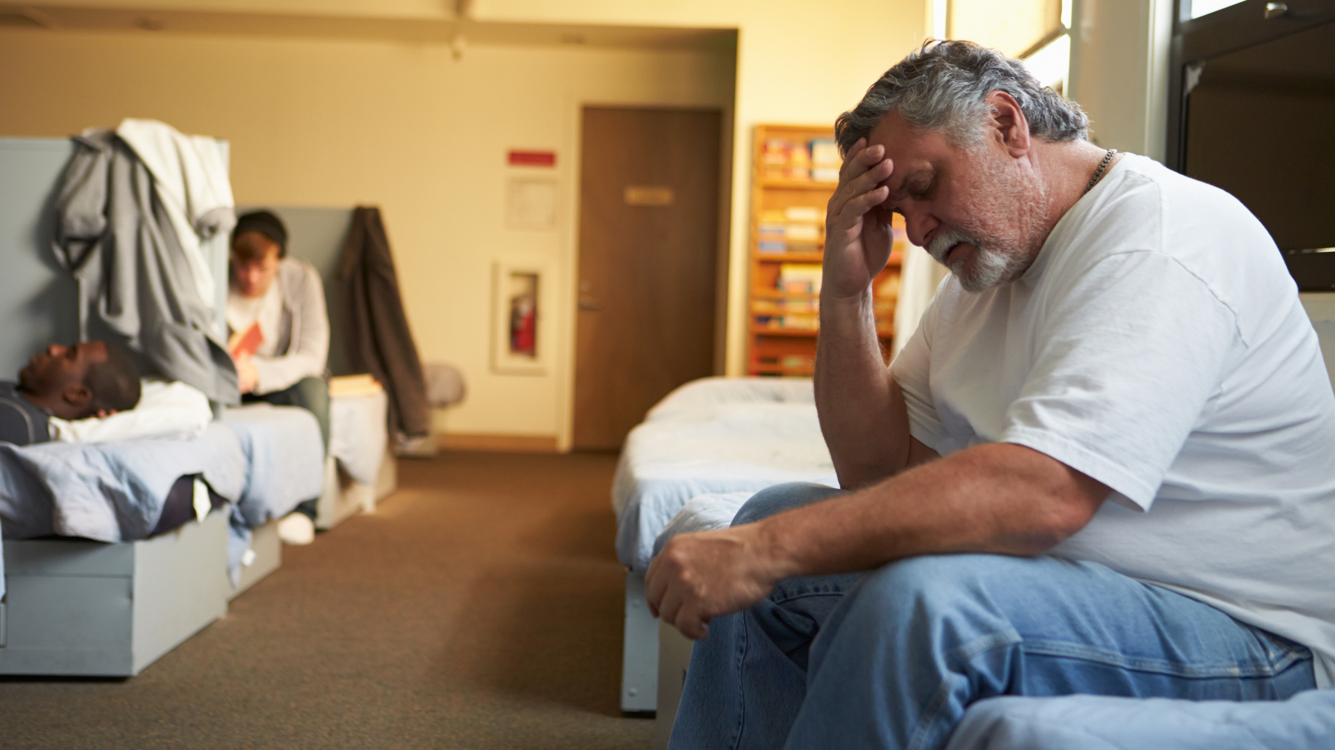
86
Sheltered Homeless Individuals and Families
From the time period of:
February 2, 2023 - February 3, 2023
(86 Sheltered)
people were experiencing homelessness
Sheltered Count

Slide 5
Total Veteran Count
Emergency Shelters
Safe Havens
Sheltered Transitional Housing
Unsheltered
Total
Total Number of Households: 0
Total Number of Persons: 0
Total Number of Veterans: 0
Total Number of Households: 1
Total Number of Persons: 2
Total Number of Veterans: 1
Total Number of Households: 7
Total Number of Persons: 8
Total Number of Veterans: 7
Total Number of Households: 8
Total Number of Persons: 10
Total Number of Veterans: 8

Slide 6
9
Homeless Adults admitted to having a serious Mental Illness

Slide 7
7
Homeless Adults admitted to having a Substance Use Disorder

Slide 8
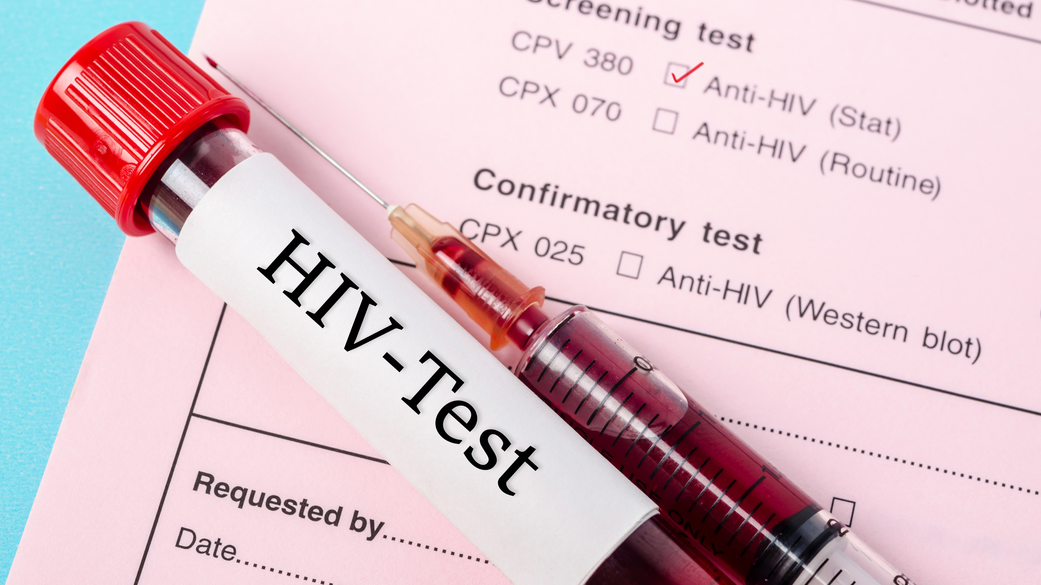
2
Adults with HIV/AIDS

Slide 9
9
Adult Survivors of Domestic Violence

Slide 10
Local Resources
Making a Difference

Slide 11
THE HOPE
CENTER

Slide 12
Transitional & Permanent Housing
Veterans
Empowering
Veterans
Emergency Shelter

Slide 13
Cumberland Healthnet
Coordinated Intake
Housing Navigation
Outreach Services
Homeless Day Center

Slide 14
Serving the Homeless with
Love and Dignity

Slide 15
Adult Literacy & Education Center
Emergency
Assistance
Add a little bit of body text
Find a Friend
Nehemiah Project

Slide 17
Cumberland Interfaith
Hospitality

Slide 18
Three (3) Different Types of Homelessness
Sheltered Homelessness
Imminent Risk of Homelessness
Unsheltered Homeless
Those who are living in uninhabitable places for people to normally dwell such as: living on the street, in cars, abandoned houses, public benches, parks, doorways to businesses and other places that can be found for shelter.
Individuals who are not living on the street but are not living on their own either. Those living in transitional housing (temporary housing) such as domestic violence shelters, emergency shelters, hotel, motels and safe havens.
Those who will lose their primary residence within 14 days and they have no other housing and lack the resources to obtain housing. Those living on the couches of another persons' home and depending on the kindness of others.
I

Slide 19
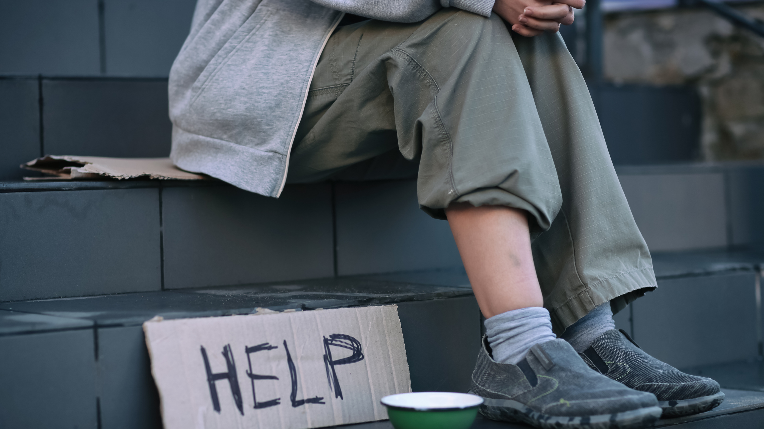
All homeless people are lazy and don't want to work
Homeless persons choose to be homeless.
All homeless persons abuse alcohol and drugs.
Helping homeless persons only enables them
MISCONCEPTIONS
HOMELESSNESS
IT'S MORE THAN YOU KNOW!
Those misconceptions are not true, homelessness is closer to one's door than you know.
SERIOUS TRUTH
Many may not realize it, but any individual or family can possibly experience homelessness by the loss of as little as two monthly paychecks due to an unforeseen event that could arise.
IT COULD HAPPEN TO YOU

Slide 20
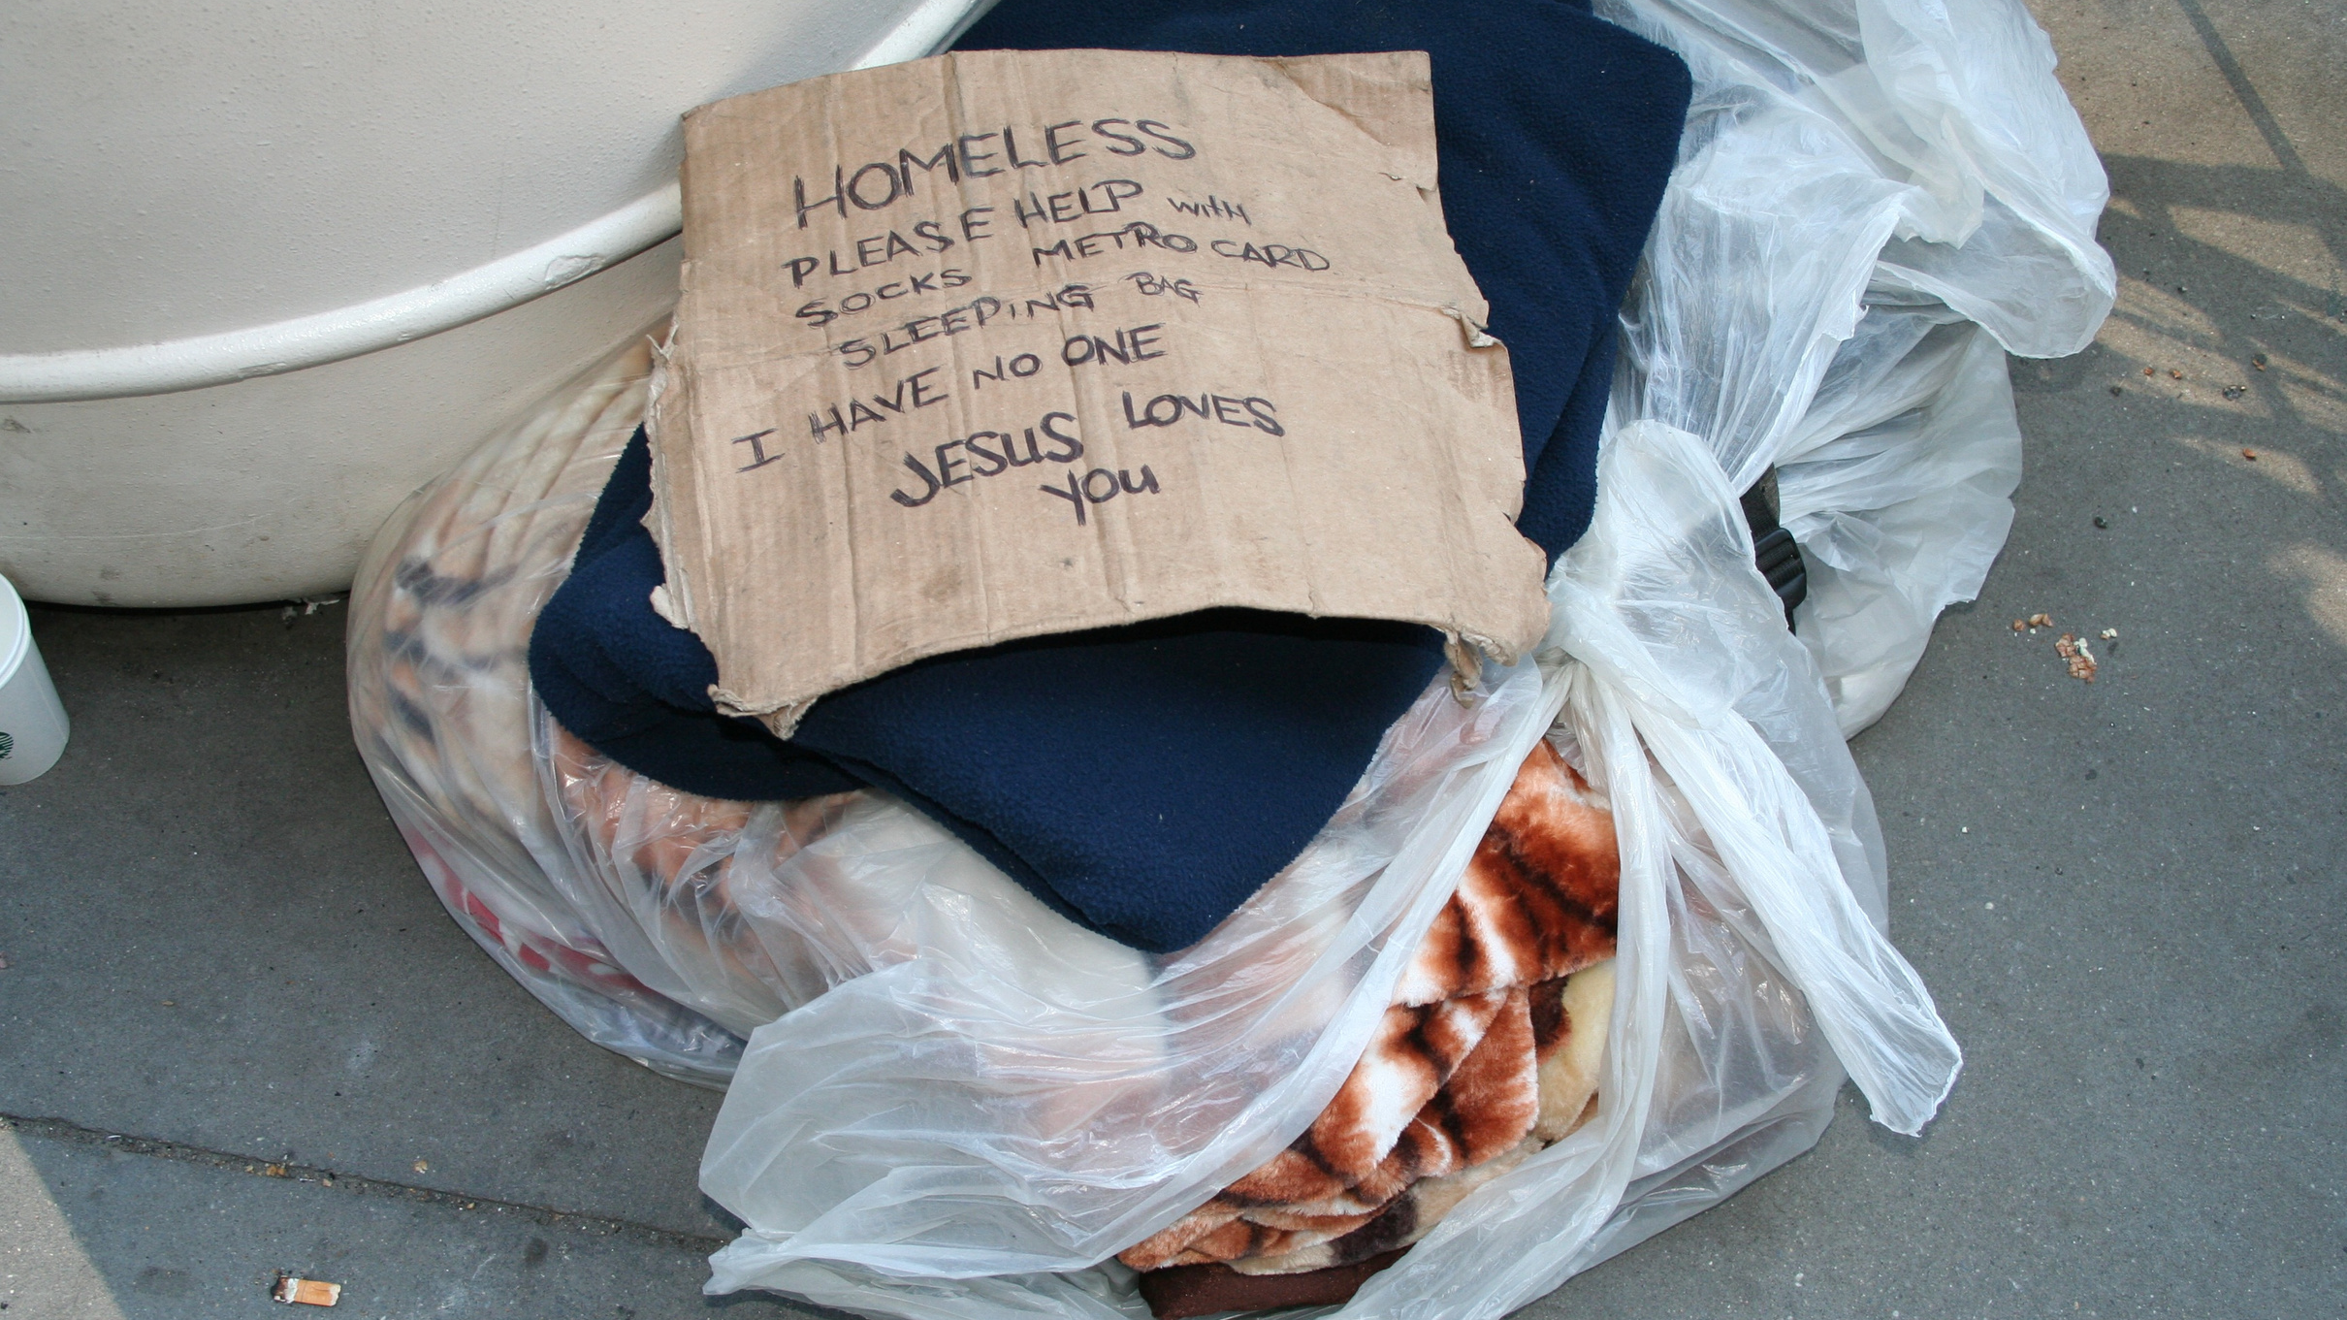
Most Common Causes of Homelessness
Loss of Employment.
Family Crisis: Divorce, loss of loved one, medical crisis.
Lack of affordable housing, eviction
Mental and or Physical Disability
Drugs/Alcohol
Domestic Violence
Incarceration
Poverty

Slide 21
Understanding the Point in Time Count (PIT)
This report is intended to provide the community with vital information regarding the many different characteristics of our homeless community. The collection of surveys is one way we use to count our homeless community. Although the surveys are thorough, they do come with limitations. The task of counting those who are experiencing homelessness is not an easy task to complete in only one night.

Slide 22
Understanding the Point in Time Count (PIT)
Although it is our goal to reach every homeless person in our community, it is almost nearly impossible to locate everyone. This count is only as accurate as the number of individuals that are located. The Point in Time Count is a snapshot of our community. These snapshots are taken each year in the hope that over a course of time we are able to observe changes and evaluate our progress in our goal to end homelessness and create an environment where everyone can live in a safe and comfortable dwelling.

Slide 23
TO OUR VOLUNTEERS
We would like to extend a special thank you to all the volunteers who gave of their time, talent, and resources to assist us during the Point-in-Time Count.
Words could never express our gratitude and appreciation.
We could not have done it without you.
This report was funded by Cumberland County Community Development, in direct partnership with the City of Fayetteville Economic and Community Development.
Prepared by Tawana Dawkins for the NC-511 Fayetteville/Cumberland County Continuum of Care.
Point of Contact: Delores Taylor, Director
Cumberland County Community Development.

